Slide 1
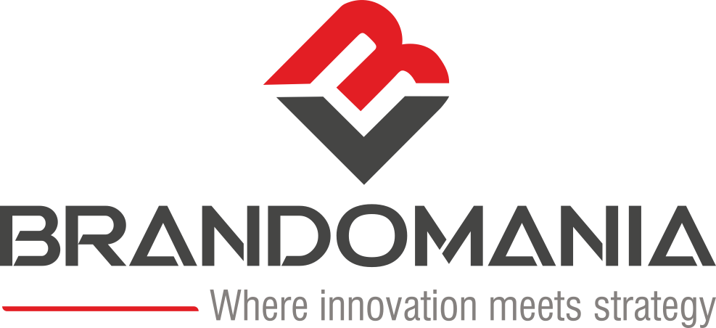
INTEGRATED MARKETING & BRAND STRATEGY
Building Brands
That Drive Real Growth.
Hyderabad's premier integrated agency where human creativity, brand architecture, and AI-powered performance intersect to create category leaders.
AGENCY CREDENTIALS · 2026
Brand Strategy
AI Digital Marketing
Integrated Campaigns
Creative Design
Web & Technology
WWW.BRANDOMANIA.IN

Slide 2
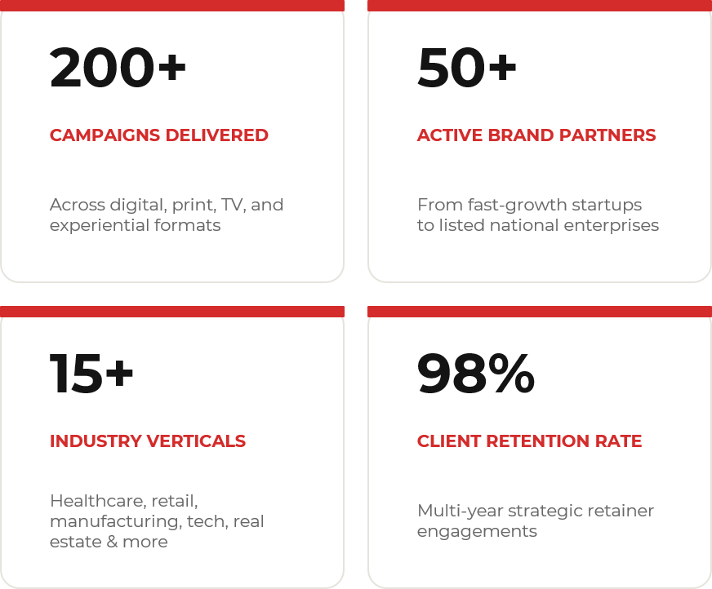
WHO WE ARE
The Agency Built for Ambitious Brands.
Strategic consulting, award-class creative design, and data-driven performance.
Our Core Purpose
Brandomania is Hyderabad's most comprehensive integrated marketing agency.
Founded with a vision to eliminate agency silos, we bring strategic consulting, award-class creative design, and high-velocity digital execution under one single roof.
By uniting AI-driven data intelligence with uncompromising creative craft, we help emerging disruptors and enterprise leaders build sustainable competitive moats.
"We don't just run campaigns. We engineer brand ecosystems that command industry leadership and deliver measurable commercial results."

Slide 3
OUR CAPABILITIES
Five Core Disciplines.
Seamlessly integrated to engineer end-to-end brand momentum.
01
02
03
04
05
Creative Design
Web & Technology
AI-Powered Digital Marketing
Brand Strategy & Identity
Integrated Marketing
High-performance digital products, web applications, and headless e-commerce engineered for conversion.
Data-driven performance campaigns enhanced by machine learning algorithms for scalable ROI across channels.
Definitive market positioning, naming conventions, and architectural frameworks that establish lasting brand equity.
Category-defining visual assets — packaging, motion graphics, and editorial systems that command attention.
Cohesive multi-channel campaigns amplifying brand presence from print & OOH to digital, PR, and influencers.
SEO · Meta · Google Ads · Programmatic
ATL · BTL · Influencers · PR
Visual Identity · Packaging · Motion
Positioning · Naming · Architecture
UI/UX · Web Apps · E-Commerce

Slide 4
OUR JOURNEY
From 2016 to Industry Leadership.
A decade of relentless focus on building brands that matter.
2016
Founded in Hyderabad by S. Ramesh Babu
10 Yrs
Agency Inception
Launched with a singular mission: to eliminate agency silos and offer clients a united engine of strategy, creative, and technology.
PROVEN EXCELLENCE
2018
Retail & Brand Structuring Milestones
Retail Dominance
200+
Led comprehensive brand hierarchy and retail positioning for regional retail icons including Ratnadeep, Maruti Ispat, and GP Agarwal Group.
SUCCESSFUL LAUNCHES
2020
Healthcare Retail & National Campaigns
National Footprint
Structured in-store visual merchandising and consumer engagement for MedPlus (India's leading listed pharmacy network) alongside national campaigns.
15+
INDUSTRY VERTICALS
2023
Launch of AI-Driven Performance Division
AI Transformation
Pioneered programmatic AI optimization, automated analytics, and high-conversion e-commerce funnels for 50+ enterprise brand partners.
98%
2026
Hyderabad's Premier Integrated Agency
Present Day
CLIENT RETENTION
200+ campaigns executed across 15+ industries with 98% client retention rate. Trusted partner for startups to listed enterprises.

Slide 5
WHY BRANDOMANIA
What Sets Us Apart.
Six reasons market leaders choose us as their long-term growth partner.
🏗️
01
🤖
02
📊
03
Unified Ecosystem
AI-Augmented Execution
Data-Grounded Strategy
Strategy, creative design, digital performance, and tech completely integrated under one roof. No friction, no diluted briefs.
We leverage predictive AI models to optimize media spends, target hyper-specific audiences, and lower customer acquisition costs.
Every creative concept and media plan is anchored in real customer behavioral research and verified market performance metrics.
🎨
04
🌐
05
🤝
06
Category-Grade Creative
Cross-Sector Mastery
True Growth Partnership
Award-winning visual identities, editorial design, and packaging systems crafted to command authority in competitive markets.
Deep domain expertise across retail FMCG, healthcare, automotive, real estate, manufacturing, infrastructure, and technology.
We act as your dedicated growth team with direct accountability to commercial revenue milestones, not just vanity impressions.

Slide 6
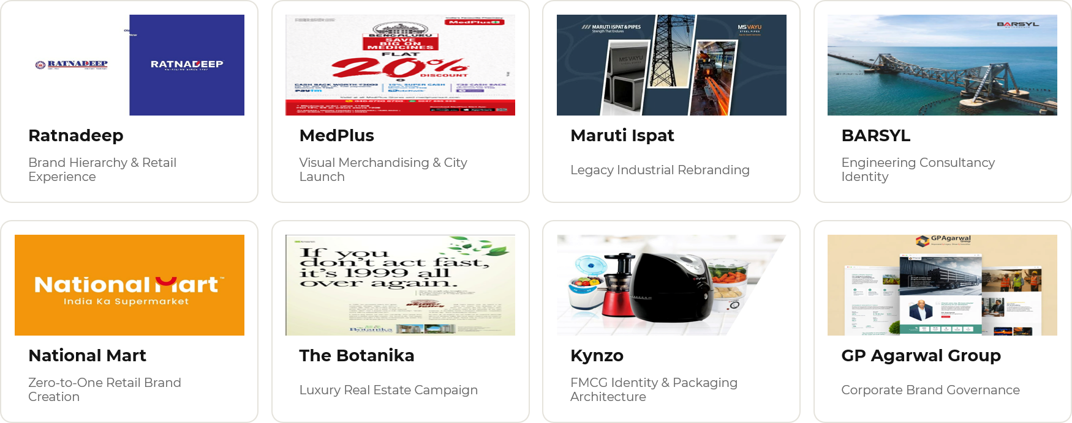
SELECTED PORTFOLIO
Brands We've Transformed.
Proven impact across major commercial enterprises.

Slide 7
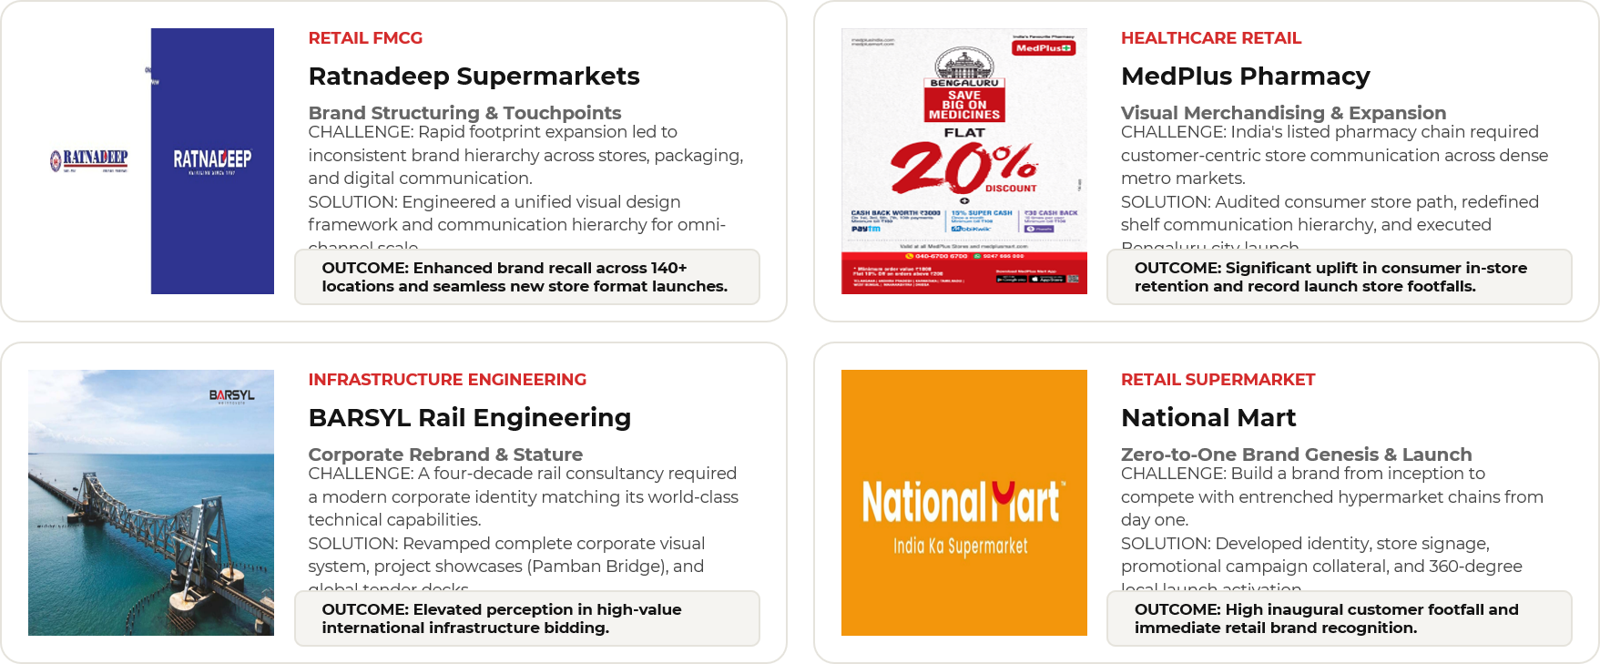
DEEP DIVES
Strategic Transformation in Action.
A closer look at how we solve complex commercial brand challenges.

Slide 8
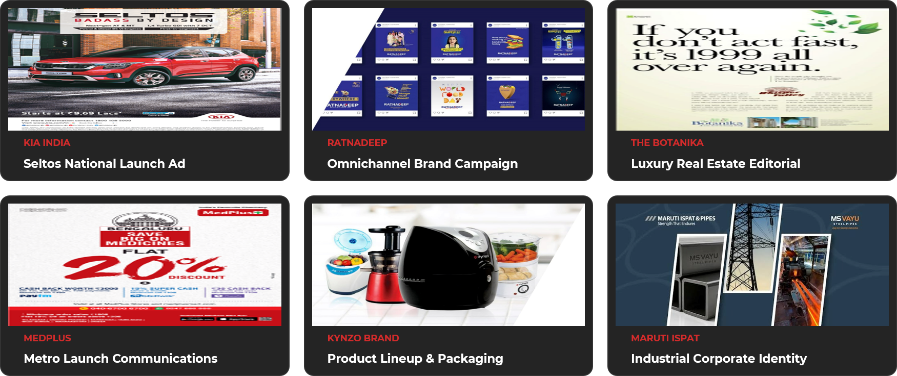
WORK SHOWCASE
Craft in Every Pixel.

Slide 9
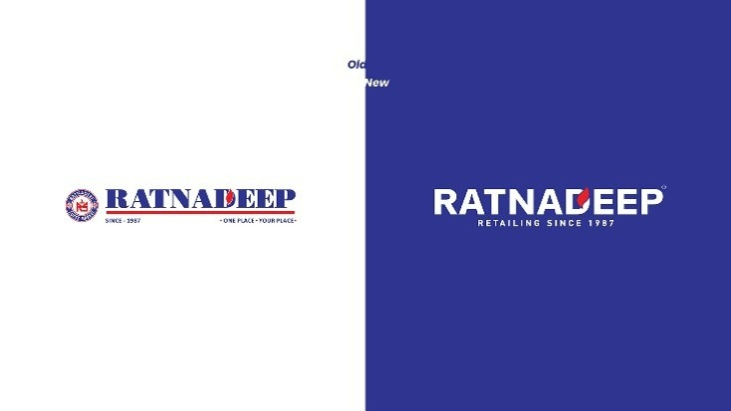


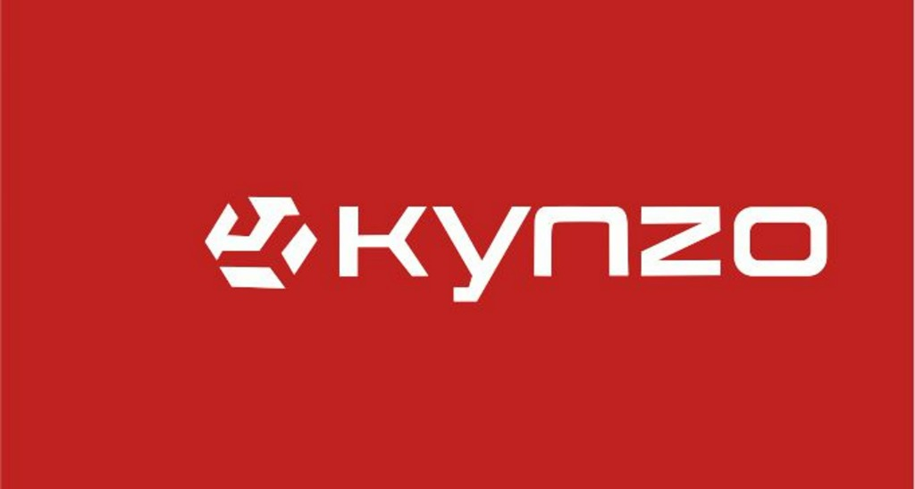
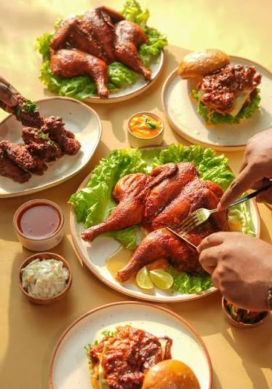
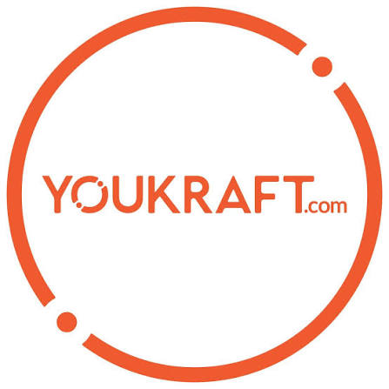
CLIENT PARTNERSHIPS
Trusted Brands Across Sectors.
We partner with listed healthcare leaders, FMCG brands, infrastructure consultants, and luxury developers.
BARSYL
The Botanika
RAIL ENGINEERING
LUXURY REAL ESTATE
Maruti Ispat
GP Agarwal Group
Lusso Italia
Sunshine Hospitals
STEEL & POWER
CONGLOMERATE
LUXURY FURNITURE
HEALTHCARE NETWORK
EXPERTISE ACROSS: 🛒 FMCG & Retail · ⚕️ Healthcare · 🏢 Real Estate · 🏭 Manufacturing · 🍔 Food & Beverage · 🚂 Rail Infrastructure · 💻 Tech & SaaS

Slide 10
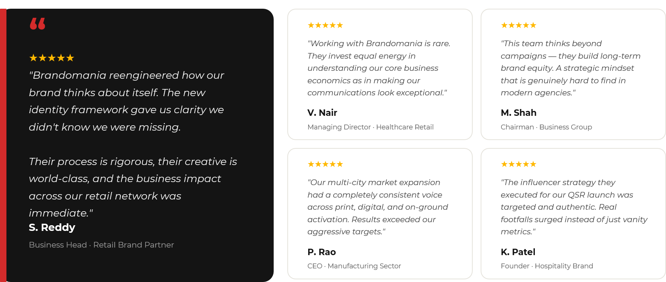
CLIENT ENDORSEMENTS
What Our Partners Say.
Long-term relationships built on measurable commercial performance.

Slide 11
OUR METHODOLOGY
The 10-Step Growth Engine.
A structured, data-tested roadmap from diagnostic audit to market scale.
01
02
03
04
05
Discovery Audit
Market Research
Brand Strategy
Campaign Architecture
Creative Direction
In-depth brand, market, and consumer perception audit to identify real commercial growth vectors.
Quantitative and qualitative competitive landscape mapping to isolate whitespace opportunities.
Positioning matrix, value propositions, and core messaging frameworks aligned to revenue goals.
Omnichannel channel mix, funnel design, budget allocation, and attribution planning.
High-impact visual ideation, copy crafting, and multi-format production of campaign assets.
06
07
08
09
10
Precision Execution
AI Optimization
KPI Reporting
Knowledge Loop
Scale & Expand
Simultaneous deployment across digital, OOH, print, PR, and programmatic channels.
Daily machine-learning bid adjustments, creative variant testing, and audience refinement.
100% transparent dashboard reporting tracking ROAS, CAC, lead velocity, and brand lift.
Systematic capture of campaign learning to continuously lower acquisition costs over time.
Doubling down on validated channels to aggressively scale market share and brand equity.

Slide 12
GET IN TOUCH
Ready to Accelerate Your Brand?
Let's Build
Something Iconic.
Our senior strategists are available for a confidential discovery session to evaluate your market positioning and growth roadmap.
🌐
OFFICIAL WEBSITE
www.brandomania.in
Your brand deserves more than an ad vendor.
It deserves an ambitious growth partner committed to making it the benchmark in its category.
📞
DIRECT PHONE
+91 95424 12007
📍
HEADQUARTERS
Hyderabad, Telangana, India
𝕏
TWITTER / X
@brandomaniadm
📅 Book a Strategy Session →

